Slide 1
Predicting Success on Kickstarter: A Data-Driven Approach
Insights into the Features that Determine Campaign Outcomes
Felix Kolodziej

Slide 2
Project Overview
What is Kickstarter?
Overview of Project Goal
What to expect
Notes:
Brief Introduction to Kickstarter:
Explain that Kickstarter is a crowdfunding platform helping creators bring projects to life.
Overview of Project Goals:
State that the project aims to identify key factors predicting the success of Kickstarter campaigns.
375.000 Projects from 2009 -> 2018
What to Expect:
key findings and strategic recommendations.

Slide 3
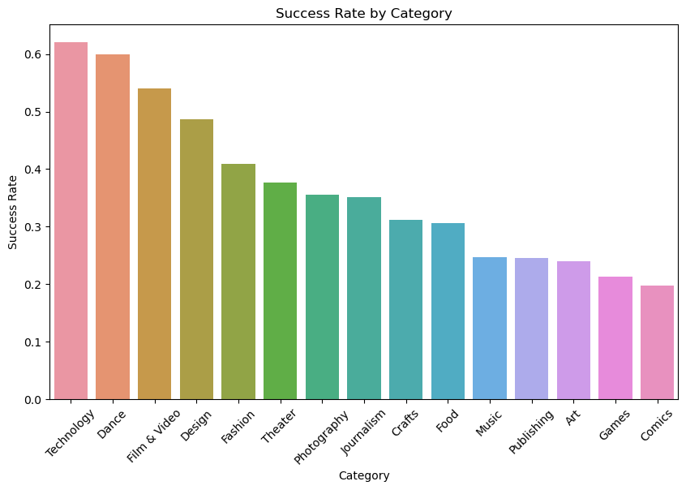
Success Rate by Category
Notes:
Variability in Success Rates:
Explain that success rates differ significantly across categories.
Category Performance:
Use the "Success Rate by Category" chart.
identify which categories perform best and which lag behind.

Slide 4
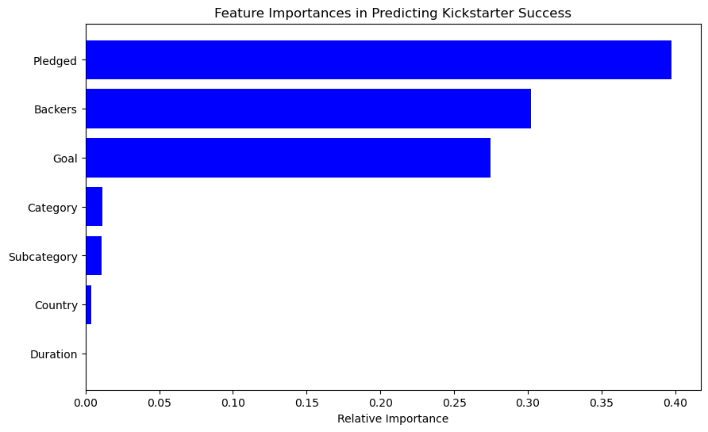
What Drives Kickstarter Success?
Notes:
Discuss Feature Importance:
Explain that feature importance reveals how much each variable contributes to the prediction of success.
Critical Features Highlighted:
Use the feature importance image to point out that Pledged amount, number of Backers, and Goal amount are most predictive.

Slide 5
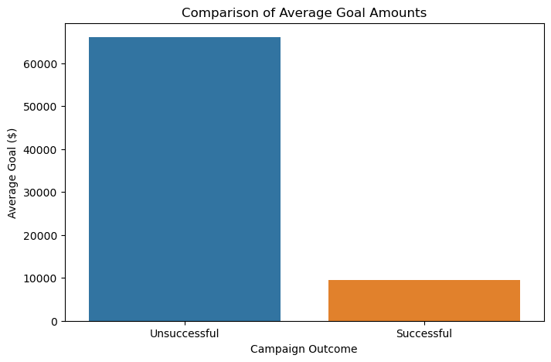
The Impact of Goal Setting on Success
Notes:
Impact on Success Rates:
Discuss how achievable goals correlate strongly with higher success rates.
Average Goals Comparison:
Present the "Comparison of Average Goal Amounts" graph.
Highlight the significant disparity in goal amounts between successful and unsuccessful campaigns.

Slide 6
Strategic Implications for Campaign Creators
Recommendations based on the findings:
Community Building
Set achievable goals
Notes:
Community Building and Engagement:
Stress the importance of early and active engagement with potential backers.
Setting Achievable Goals:
Provide tips on using historical data to set realistic funding targets.
Category Selection:
Advise on choosing the right category based on historical success rates and project alignment.

Slide 7
Conclusion To predict a successful Campaign
What Matters?
Backers
Pledged Amount
The Goal
Notes:
Key Findings Recap:
Summarize the crucial insights gained from the analysis.
Implications for Future Campaigns:
Highlight how these findings can be applied to enhance the success rates of future Kickstarter projects.

Slide 8


